Slide 1
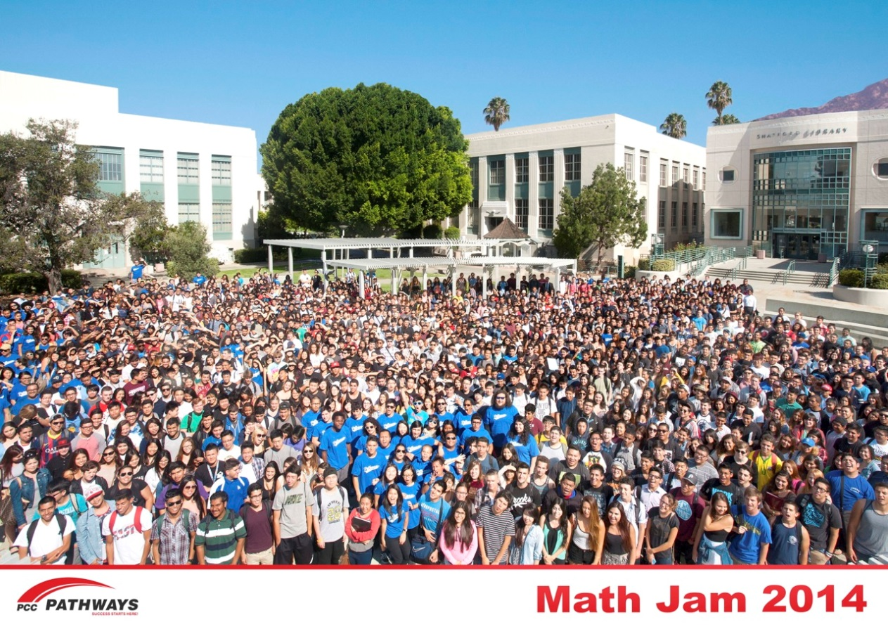
Pasadena City College’s
First Year Pathway
OCTOBER 10, 2014

Slide 2
FYP Growth

Slide 3
XL: First and Second Year Pathways
Year 1
Fall
English
Year 1
Spring
English
Year 2
Required hybrid course with support
Math
College 1
Math
GE or Speech 1
GE
Leadership
Coaching, counseling, & ePortfolio support
Speech 1 or GE
Peer mentoring
Service learning
Peer tutoring
Career Quest
Declared major
Two-year ed plan
ePortfolio

Slide 4
EMP
Student Success, Equity, and Access
Professional Development
Pathways
Student Support Services
Enrollment Management
Student Success, Equity, and Access
SSTFR
Increase College and Career Readiness
Revitalize and Re-Envision Professional Development
Incentivize Successful Student Behaviors
Strengthen Support for Entering Students
Align Course Offerings to Meet Student Needs
Improve the Education of Basic Skills Students
FYP
Outreach, Career Ladders, Summer Jams, College 1
College 1 Professional Learning Institute
XL Athletes International Students Career Tech Ujima
Coaching, Tutoring, Summer Jams
Guaranteed Math/English, GE
STACC (English Composition), SLAM (Non-STEM Math)
Notes:
Can also talk about what APL is doing as well for professional Development

Slide 5
How -- High Impact Practices
First Year Seminars and Experiences
Common Intellectual Experiences
Learning Communities
Writing-Intensive Courses
Collaborative Assignments and Projects
Undergraduate Research
Diversity/Global Learning
Service Learning, Community-Based Learning
Internships
Capstone Courses and Projects
Association of American Colleges and Universities, 2014

Slide 6
FYP 2012 Cohort
Office of Institutional Effectiveness, 2014
FYP n=764, non-FYP n=4,396

Slide 7
FYP 2012 Cohort
Office of Institutional Effectiveness, 2014
FYP n=764, non-FYP n=4,396

Slide 8
Propensity Score Matching
Builds a comparison group that is as similar as possible to the cohort of interest (FYP)
Approximates random assignment (the “Gold” standard in experimental research)
Provides the ability to make stronger inferences of cause and effect
Allows us to determine if it is the treatment (FYP) or other characteristics of the FYP students that “cause” the outcomes of interest

Slide 9
FYP 2012 Cohort
Office of Institutional Effectiveness, 2014
FYP n=764, non-FYP n=4,396

Slide 10
FYP 2012 Cohort
Office of Institutional Effectiveness, 2014
FYP n=764, non-FYP n=4,396

Slide 11
FYP 2012 Cohort
Office of Institutional Effectiveness, 2014
FYP n=764, non-FYP n=4,396

Slide 12
FYP 2012 Cohort
Office of Institutional Effectiveness, 2014
FYP n=764, non-FYP n=4,396

Slide 13
In-District HSs
Out of District HSs
PCC: All HSs
PCC
PCC
PCC
PCC
CSULA
PCC
The Partnership for College Success

Slide 14
Focus Group Findings
Pathways Awareness | hs outreach, PCC orientation
Priority Registration | #1 motivation
Meeting People | Best part of Jam
College 1 | Most helpful component -- time management
Time Management & academic planning | What students want and need most
Math placement | Unprepared for test, placed low
Resource centers | Awesome!
Pathways staff | Welcoming, accessible, helpful, esp. coaches
Pathways Focus Groups, 2013-14
# of groups: 27, # of students: 131

Slide 15

http://pccproject90.org/test-pathway/

