Slide 1


Pasadena City College’s First Year Pathway: Boutique to Behemoth
STRENGTHENING STUDENT SUCCESS CONFERENCE
COSTA MESA, OCTOBER 10, 2014

Slide 2
Workshop Goals
In this workshop, we will demonstrate and engage you in the process of how we scaled up and sustained Pasadena City College’s First Year Pathways (FYP) program.
By the end, we hope you will have the knowledge and tools to do the same at your college.

Slide 3
Who is in the room?
Who is not in your room who should be?

Slide 4

Dream/Pair/Share
What will your FYE program look like in five years?

Slide 5
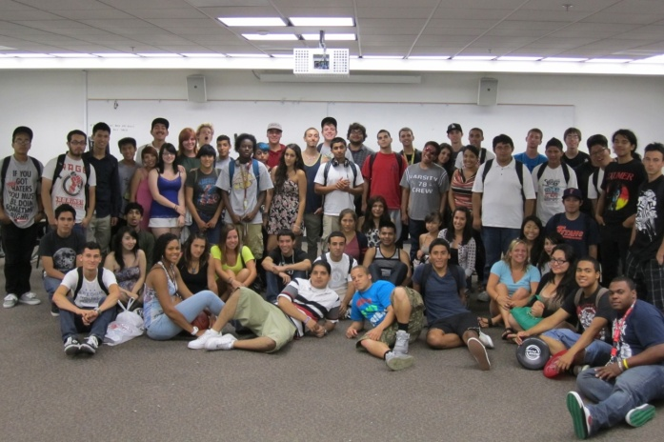
Math Jam 2011

Slide 6
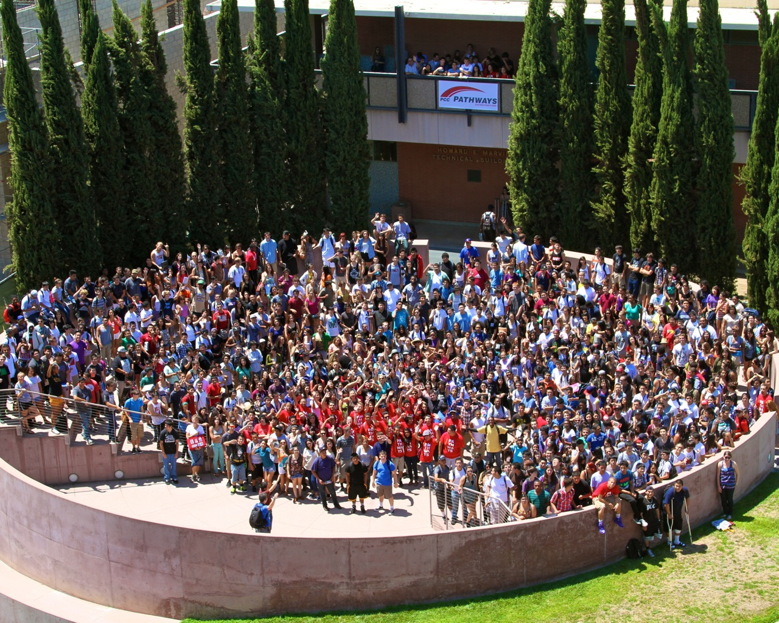
Math Jam 2012

Slide 7
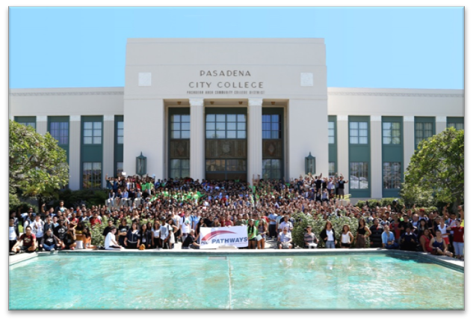
Math Jam 2013

Slide 8
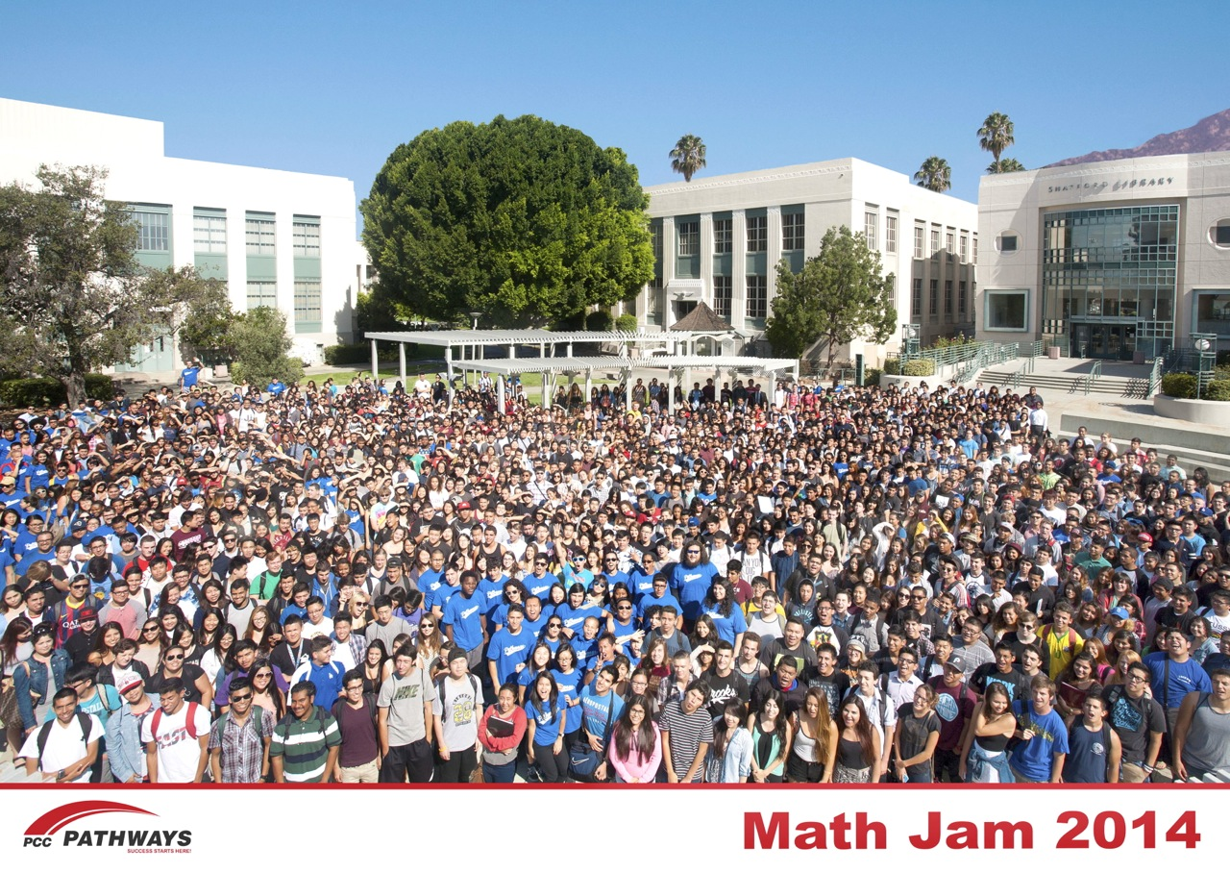

Slide 9
FYP Growth

Slide 10
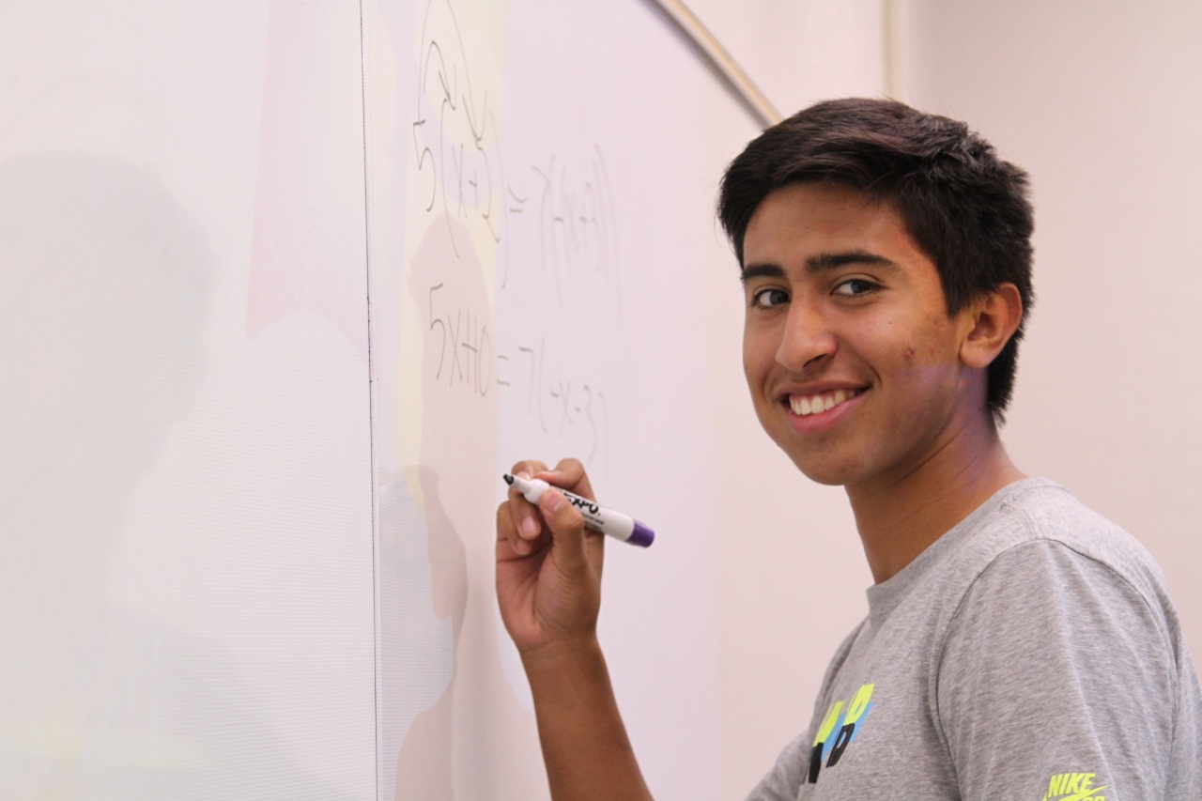
How do we scale up and not lose Danny?

Slide 11
What’s what?
Enrollment management
Curriculum redesign
Professional learning
Career exploration
High school outreach
Dual enrollment
Second Year Pathway
Completion Center
Partnerships with four-year schools

Slide 12
Why: Finding Your Noble Purpose
Find someone here that you don’t know.
Spend a few minutes talking about why you came to this session and what you hope to learn.
Be prepared to share what you learned from your partner(s) with the whole group.

Slide 13



Boutiques, Silos, and Guerilla Warfare
A Brief History

Slide 14
Getting into the room
Debunking the myths
Identifying our noble purpose
Coordinating efforts
Reallocating resources
A Brief History

Slide 15
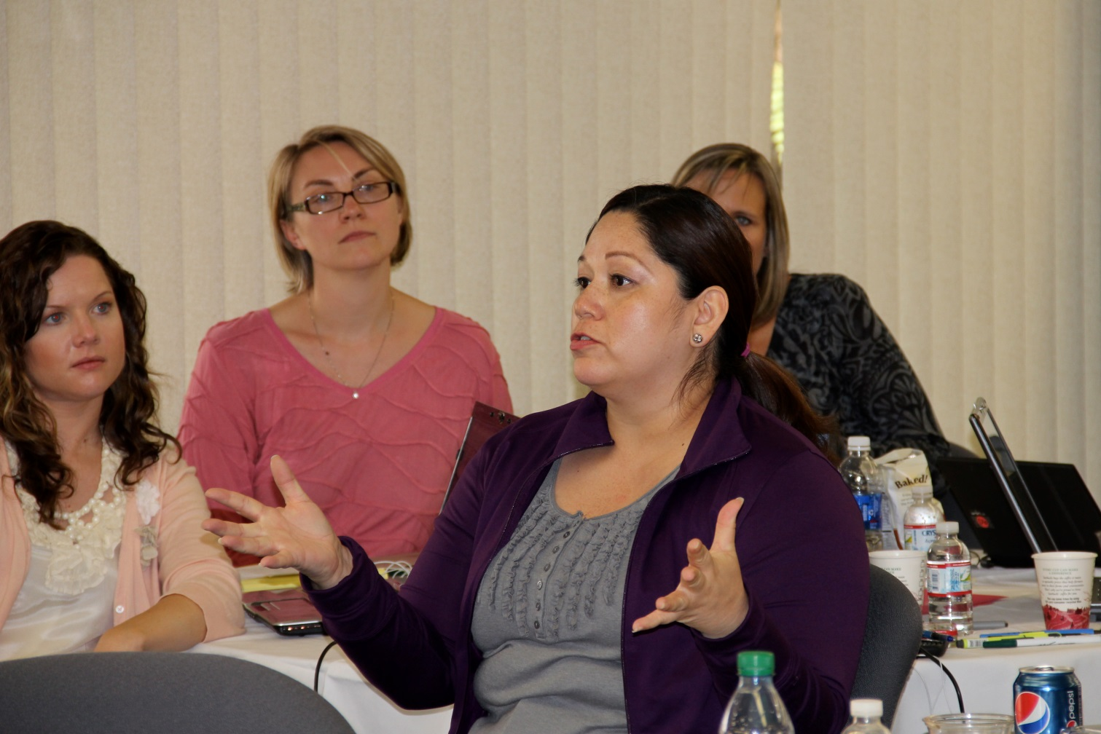
KWest 1 Retreat

Slide 16
5,537
Number of first time students who enrolled at PCC in 2004
Why?

Slide 17
The 5,537 6 years later
Developmental Education
N = 3,408
12% earned an AA/AS
5% earned a certificate
25% transferred
69% had no discoverable milestone
Non-Dev Education
N = 2,129
10% earned an AA/AS
4% earned a certificate
41% transferred
55% had no discoverable milestone

Slide 18
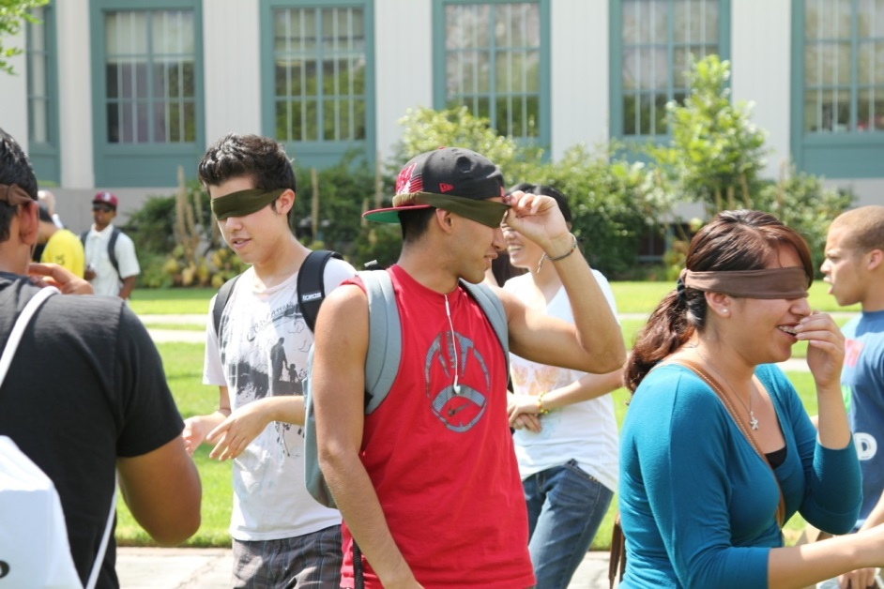
PCC’s FIRST YEAR PATHWAYS
XL
Athletes
International
Career
Ujima

Slide 19
Who
FYP Staff
Associate Dean of Pathways
Center Coordinator
English, ESL, Math, and Counseling leads
Outreach and Recruitment Coordinator lead
Counselors, Coaches and Tutors
First Year Pathways Council
Program coordinators
Academic & Counseling VPs and Deans
Enrollment Management staff
Outreach, A&R, Assessment, Research staff

Slide 20
What -- FYP Essential Components
Outreach and recruitment
Pre-assessment workshops
Priority registration
Summer Orientation
Student Success Team
Required first-year schedules
College 1, One Book, One College, Student Conference
Study/resource centers

Slide 21
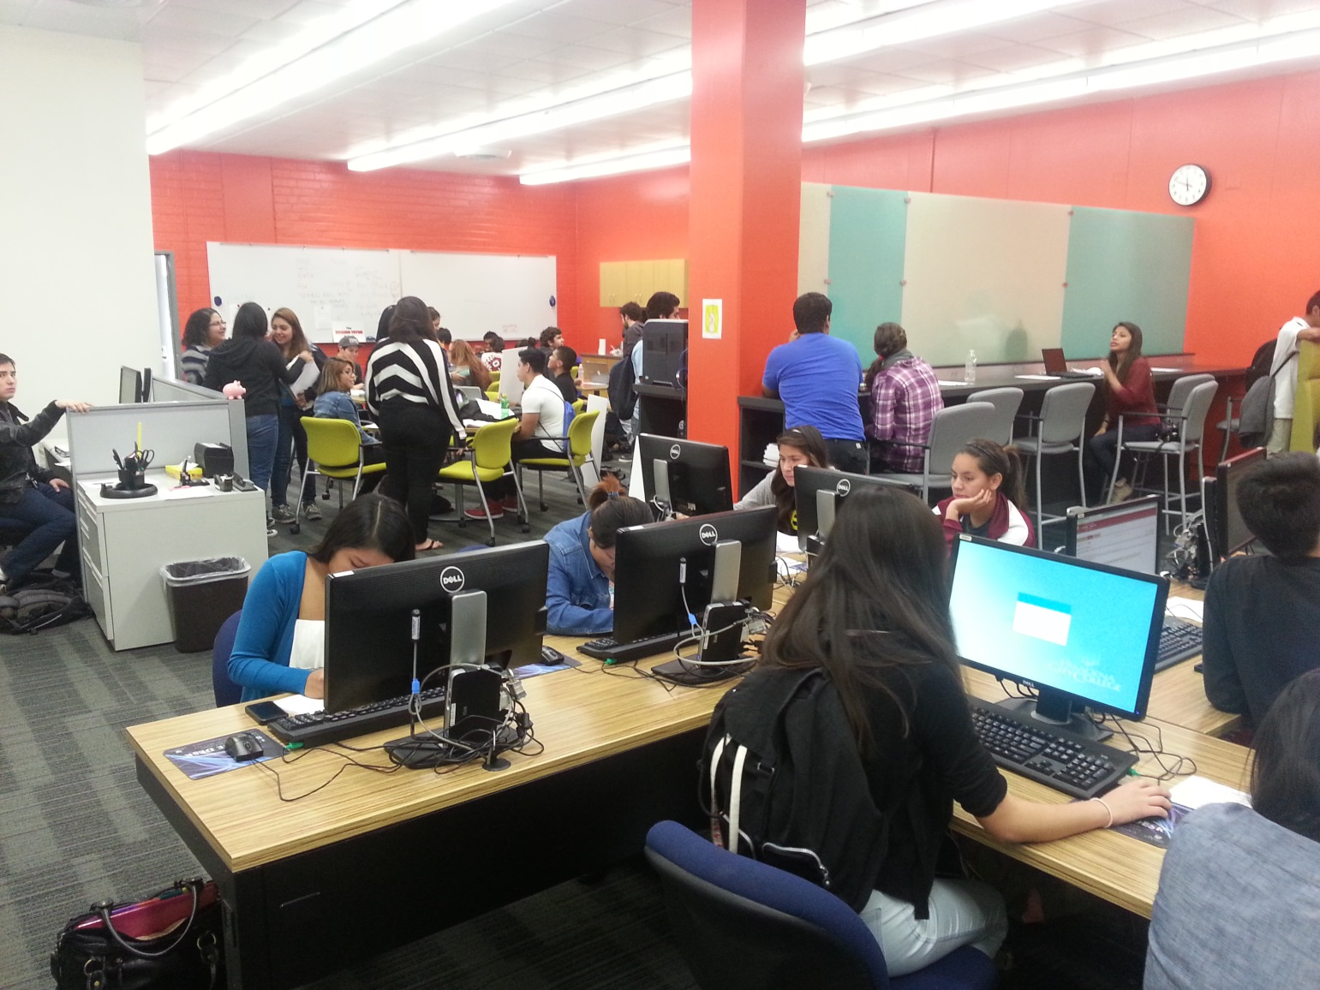
A Room of Their Own

Slide 22
The First Year Pathways Process
Fall High school outreach/recruitment
April PCC application, pre-assessment prep,
on-site placement assessment, FYP application
June/July Info sessions at PCC -- guaranteed full schedule, priority registration
August Summer bridges (Math Jam, iJam, and Design Jam)
Fall Full-time student status
Contract and passport
“One Book, One College” and FYP Student Conference
Spring Full-time student status
Contract and passport
Career exploration

Slide 23
XL: First and Second Year Pathways
Year 1
Fall
English
Year 1
Spring
English
Year 2
Required hybrid course with support
Math
College 1
Math
GE or Speech 1
GE
Leadership
Coaching, counseling, & ePortfolio support
Speech 1 or GE
Peer mentoring
Service learning
Peer tutoring
Career Quest
Declared major
Two-year ed plan
ePortfolio

Slide 24
EMP
Student Success, Equity, and Access
Professional Development
Pathways
Student Support Services
Enrollment Management
Student Success, Equity, and Access
SSTFR
Increase College and Career Readiness
Revitalize and Re-Envision Professional Development
Incentivize Successful Student Behaviors
Strengthen Support for Entering Students
Align Course Offerings to Meet Student Needs
Improve the Education of Basic Skills Students
FYP
Outreach, Career Ladders, Summer Jams, College 1
College 1 Professional Learning Institute
XL Athletes International Students Career Tech Ujima
Coaching, Tutoring, Summer Jams
Guaranteed Math/English, GE
STACC (English Composition), SLAM (Non-STEM Math)
Notes:
Can also talk about what APL is doing as well for professional Development

Slide 25
Triple entry log activity
YOUR NEEDS | YOUR RESOURCES | YOUR GAPS

Slide 26
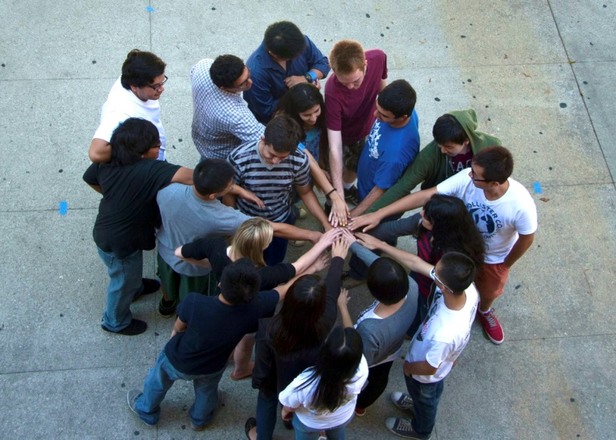
How -- High-Impact Practices
Quality
Scale
Intensity
“Until colleges make high-impact practices inescapable for all students who need them, these practices will be only minimally effective in promoting the major gains sought in student success and completion.”
A Matter of Degrees, CCSSE, 2013

Slide 27
How -- High Impact Practices
First Year Seminars and Experiences
Common Intellectual Experiences
Learning Communities
Writing-Intensive Courses
Collaborative Assignments and Projects
Undergraduate Research
Diversity/Global Learning
Service Learning, Community-Based Learning
Internships
Capstone Courses and Projects
Association of American Colleges and Universities, 2014

Slide 28
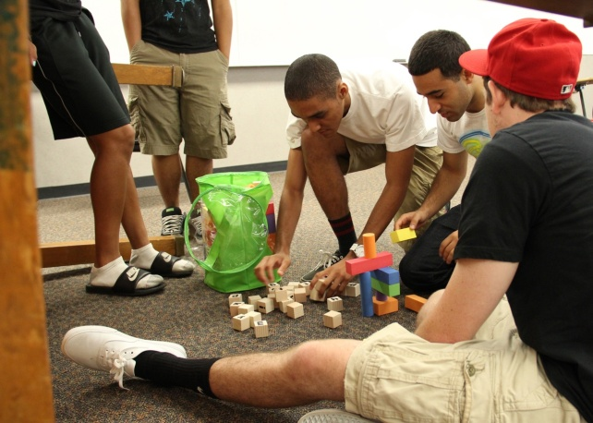
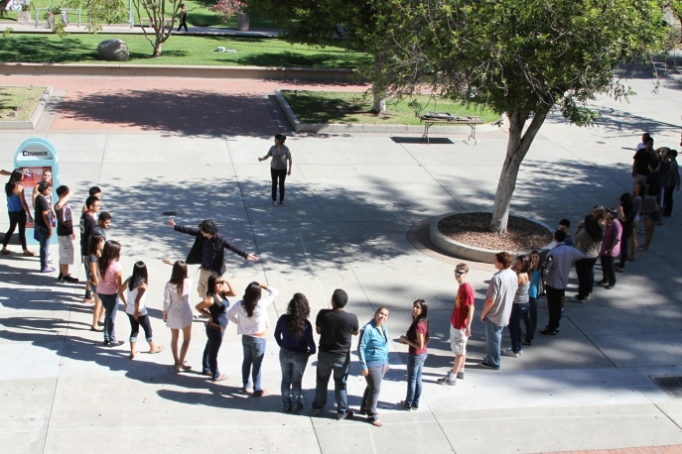
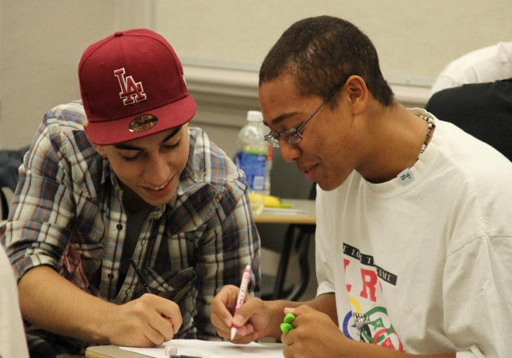
SUMMER JAM

Slide 29
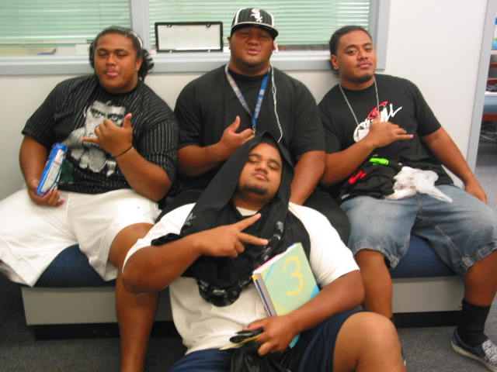
Short-term
Outcomes
Connectedness to campus
Awareness of support services and resources
Creation of a network of support
Improved attitude toward math, counseling, and tutoring
Notes:
You’ll noticed that our short term outcomes have nothing to do with math. We noticed this from the other programs that we’ve created for years that we were not going to see a very very fast turn around in math behaviors and outcomes after a two week intervention, that’s just not going to happen. But what we did hope for was to to create an environment where student felt comfortable, where they felt connected to the college, understood what support services were available to them, and that they were able to make friends with peers, faculty, tutor, their support team.
We wanted to see improvement in toward their attitudes of themselves as students in the college setting, specifically around math, counseling and tutors. Critical, we have done work with another program and a major qualitative finding was that at the lowest developmental level, Prealgebra, it wasn’t necessarily about if the student could do the math, but helping them understand that they COULD do the math. It’s really a self efficasy issue. That a student understand where the obsticals are and is able to overcome them either alone or with others.

Slide 30
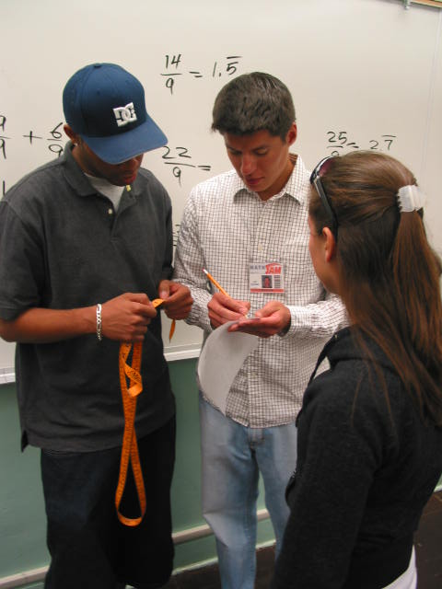
Long-term
Outcomes
Change in behavior
  increased confidence
  productive engagement in class
  regular use of college resources
Increased retention and success in developmental education math
Notes:
Of course we have long term outcomes and we are tracking these outcomes long term. We want to see change in behavior, we want to see whether they were making use of tutoring for example, and of course our traditional outcome of retention and success. Whether this was positively influenced as well.

Slide 31
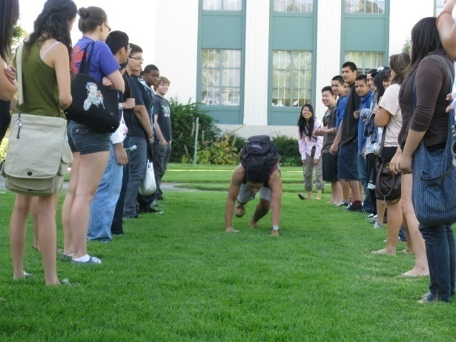
Notable Math Jam
Characteristics
Stress-free environment in which to study math
Interactive, problem-based learning curriculum
Creation of tutor/tutee relationship
Tutor learning, empowerment, and community building
Engagement between student tutors and instructors
Professional development for instructors
Notes:
As I said Math jam is a stress free environment, no credit programs. We feel that it is important to maintain that, school is stressful, we understand from all of the work that we have done in the TLC that new students are generally stressed about what is going to happen to them in college and we tried to create a worm and welcoming environment were they feel comfortable to enter the experience.
Every year of Math Jam, we develop curriculum and we now have set curriculum, which is in the process of being reviewed for this coming summer. But it highly interactive, its applications based, the faculty present a concept and the student have hand on experience, they go outside, they get into groups, dine, playing card, in order to make sure that the math becomes very real.
Boundary crossing? Because it is a no credit environment the instructor can step back and the tutor can step forward, we fee this is very important, for students to see students just like themselves, at a higher level how have succeeded and are interacting socially with math instructors. We want the instructors to collaborate, we want the instructor to some time sit down an allow the tutor to take over the activities, and this is of course more possible in a no credit environment.
We feel that the tutors are the most important element of Math Jam. We have a strong volunteer program called CONECSION we are next door to the MESA program which is STEM base program in California. So we do have high achiving student in Math, But these are students that come from the community where our students come from. They look like them, talk like them, dress like them, but they happened to be in Calculus and they understand a lot of the problems that these student are going through, in fact we actually look to higher former Math Jam students to become tutors. We fee that that community building among tutors is really powerful.
We also fee that they relationship of the tutor an tutee is a critical one, we understand form data that the students that are most in need of tutoring are the once that are least likely to take advantage of it. It really hard for me, someone that is struggling to ask someone else for help and so we feel that it is about relationship building. So Math Jam is very very much about relationship building. “I’m going to have fun with you in the summer and I will be your tutor in the fall and spring, I will be in the learning center and sometimes be in your classroom, and im going to help you and you classmates. So this really is a different dynamic than the drop in tutoring.
And arguably more important, Math Jam has become a type of professional development for some of our faculty. They get to collaborate this their collages in different, they get to interact with campus tutors, and their own students in a different ways. And in fact many of our instructors said that this was the most fun they ever had teaching Math.

Slide 32
Student Math Jam Reflections
MathJam: http://pamelacampos.weebly.com/college-1.html
http://ellenchan.weebly.com/college-courses.html
iJam: http://hazelnut-cao.weebly.com/jam-reflection.html

Slide 33

Take a Break!

Slide 34


Slide 35
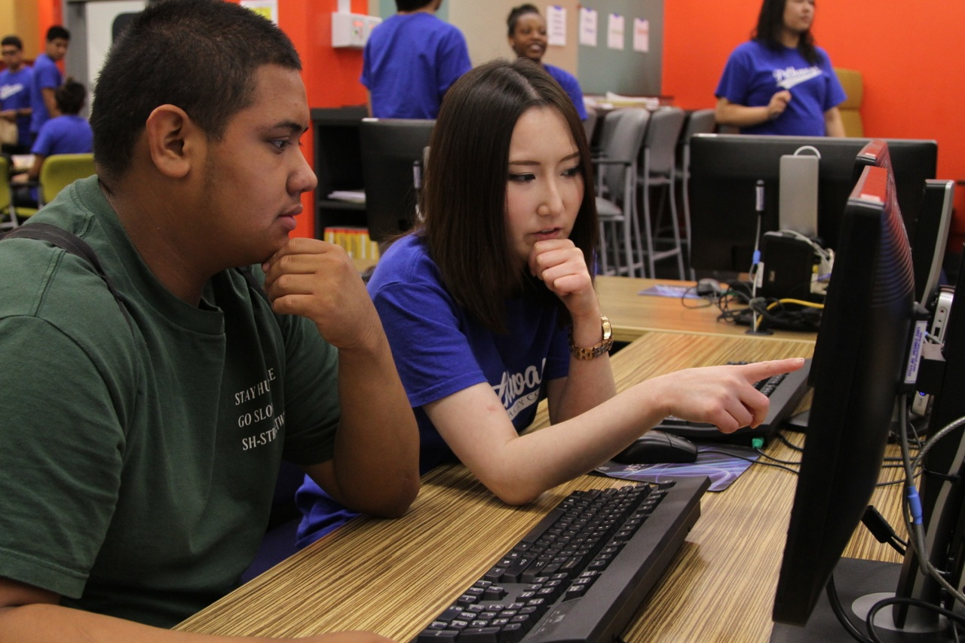
Integrating Academic Affairs and Student Services

Slide 36
A 3 unit CSU and UC transferable First Year Seminar
Critical Reading, Metacognition, Info Literacy
Embedded Reading Apprenticeship
One Book, One College Speaker Series plus Student Conference
College 1

Slide 37
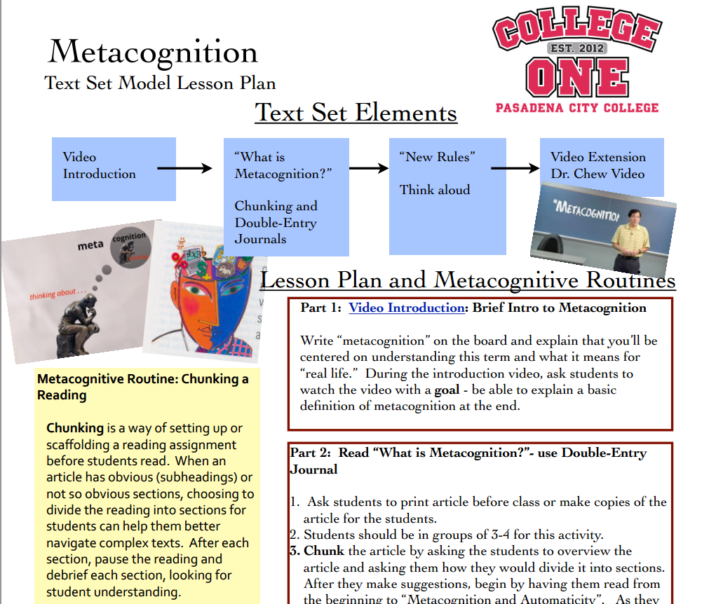
Notes:
I’m wondering if we put this here, embedded in the story, to bring home the metacognitive approach we have taken to College 1. Then when we show the CERA data, it might make more sense?
We might also want to include those screen shots of students TttT, to make visible the kinds of work we do in C1?

Slide 38
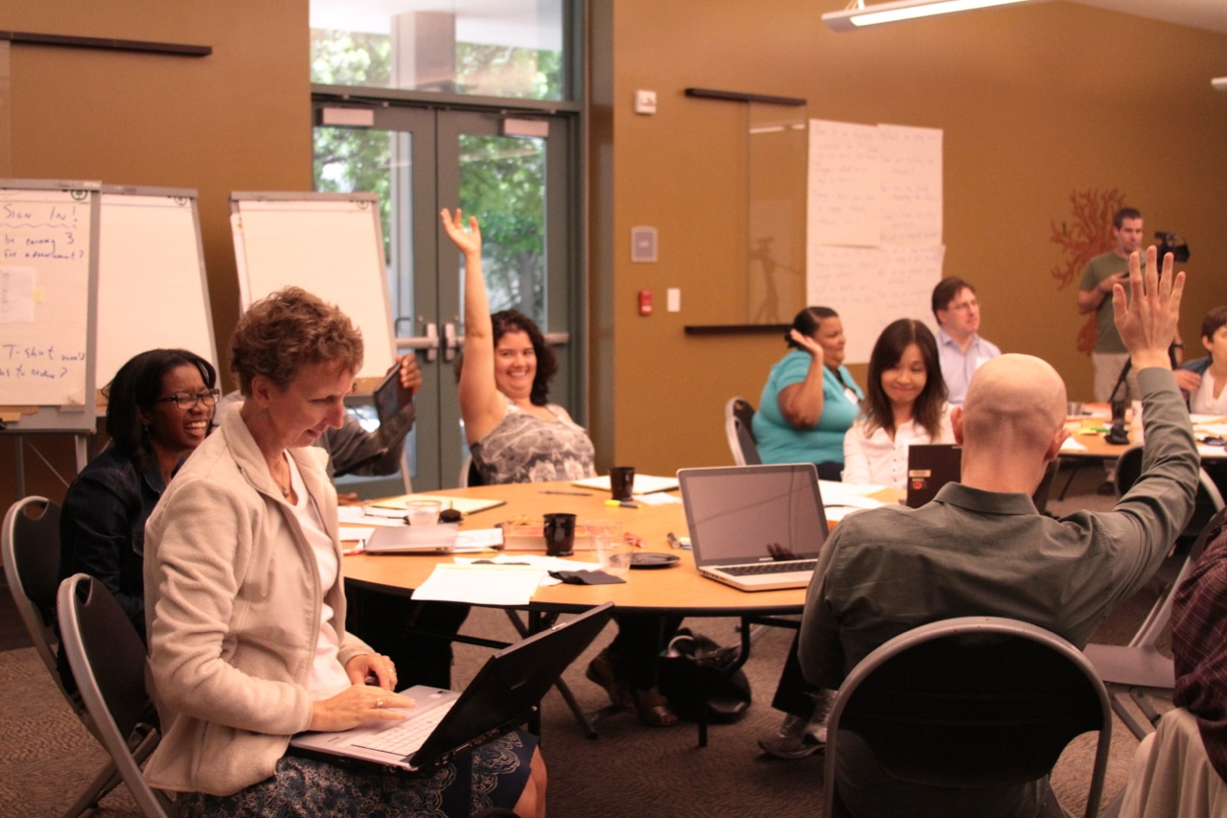
College 1 Institute
Intensive Professional Learning: 3 day summer institute with monthly follow ups
50 instructors from all 12 divisions on campus plus staff and managers
Mentor pods
College 1 Professional Learning

Slide 39
http://demystifytheeportfolio.weebly.com
ePortfolio

Slide 40
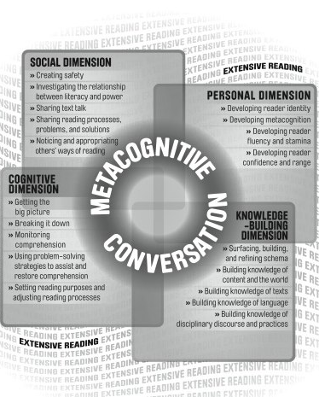
Use research-based best practices
Read together
Tolerate vulnerability
  Invite
  Assess
  Revise
Remember why
Foundational Principles

Slide 41

Jigsaw data entry activity

Slide 42
FYP 2012 Cohort
Office of Institutional Effectiveness, 2014
FYP n=764, non-FYP n=4,396

Slide 43
FYP 2012 Cohort
Office of Institutional Effectiveness, 2014
FYP n=764, non-FYP n=4,396

Slide 44
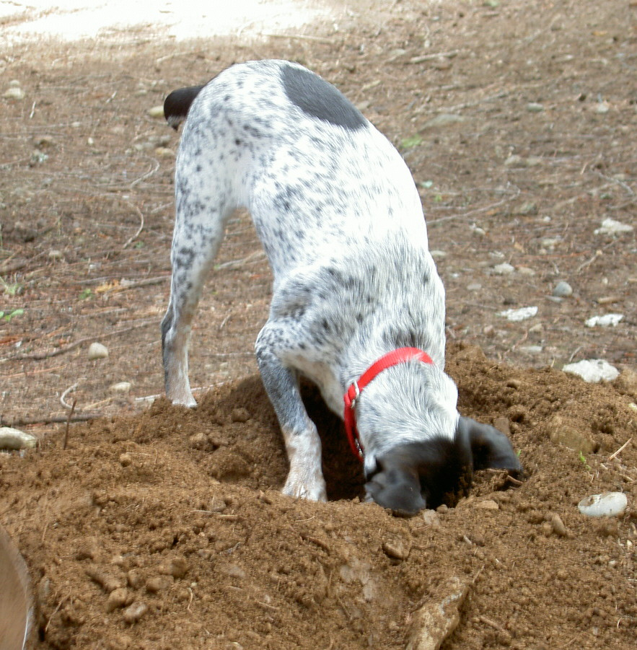



Slide 45
Propensity Score Matching
Builds a comparison group that is as similar as possible to the cohort of interest (FYP)
Approximates random assignment (the “Gold” standard in experimental research)
Provides the ability to make stronger inferences of cause and effect
Allows us to determine if it is the treatment (FYP) or other characteristics of the FYP students that “cause” the outcomes of interest

Slide 46
FYP 2012 Cohort
Office of Institutional Effectiveness, 2014
FYP n=764, non-FYP n=4,396

Slide 47
FYP 2012 Cohort
Office of Institutional Effectiveness, 2014
FYP n=764, non-FYP n=4,396

Slide 48
FYP 2012 Cohort
Office of Institutional Effectiveness, 2014
FYP n=764, non-FYP n=4,396

Slide 49
FYP 2012 Cohort
Office of Institutional Effectiveness, 2014
FYP n=764, non-FYP n=4,396

Slide 50
Focus Group Findings
Pathways Awareness | hs outreach, PCC orientation
Priority Registration | #1 motivation
Meeting People | Best part of Jam
College 1 | Most helpful component -- time management
Time Management & academic planning | What students want and need most
Math placement | Unprepared for test, placed low
Resource centers | Awesome!
Pathways staff | Welcoming, accessible, helpful, esp. coaches
Pathways Focus Groups, 2013-14
# of groups: 27, # of students: 131

Slide 51
Shared Core Beliefs
Only a campus-wide effort will eliminate the equity/achievement gap.
We must address non-cognitive as well as academic issues.
We must be evidence-informed.
Failure is not an option.

Slide 52
Strengths
A Firm Foundation -- Ten years of experience with first year experience programs
The Dream Team – A unique combination of skill sets and personalities
Our North Star – The Educational Master Plan
The L Word – Solid leadership and support from administration

Slide 53
Challenges
Allocating scarce resources
One initiative or many?
Priority registration and other incentives
Why do I need College 1?
How big can we get?
Communicate, communicate, communicate

Slide 54
Breakthroughs/Game-changers
Alignment with the EMP & Bd. Goals
Change in policy for priority registration
College 1 -- 3-units & UC/CSU transfer status
Units from HR for professional development

Slide 55

What challenges do you face?

Slide 56
We’re Here to Help!
Project Management & Math Jam: Brock Klein bmklein@pasadena.edu
Academic & Student Affairs Integration: Cynthia Olivo cdolivo@pasadena.edu
Coaching and Tutoring: Lily Tran jxtran@pasadena.edu
College 1: Shelagh Rose serose@pasadena.edu
Evaluation: Crystal Kollross cakollross@pasadena.edu
Evaluation: Dustin Tamashiro djtamashiro@pasadena.edu

Slide 57
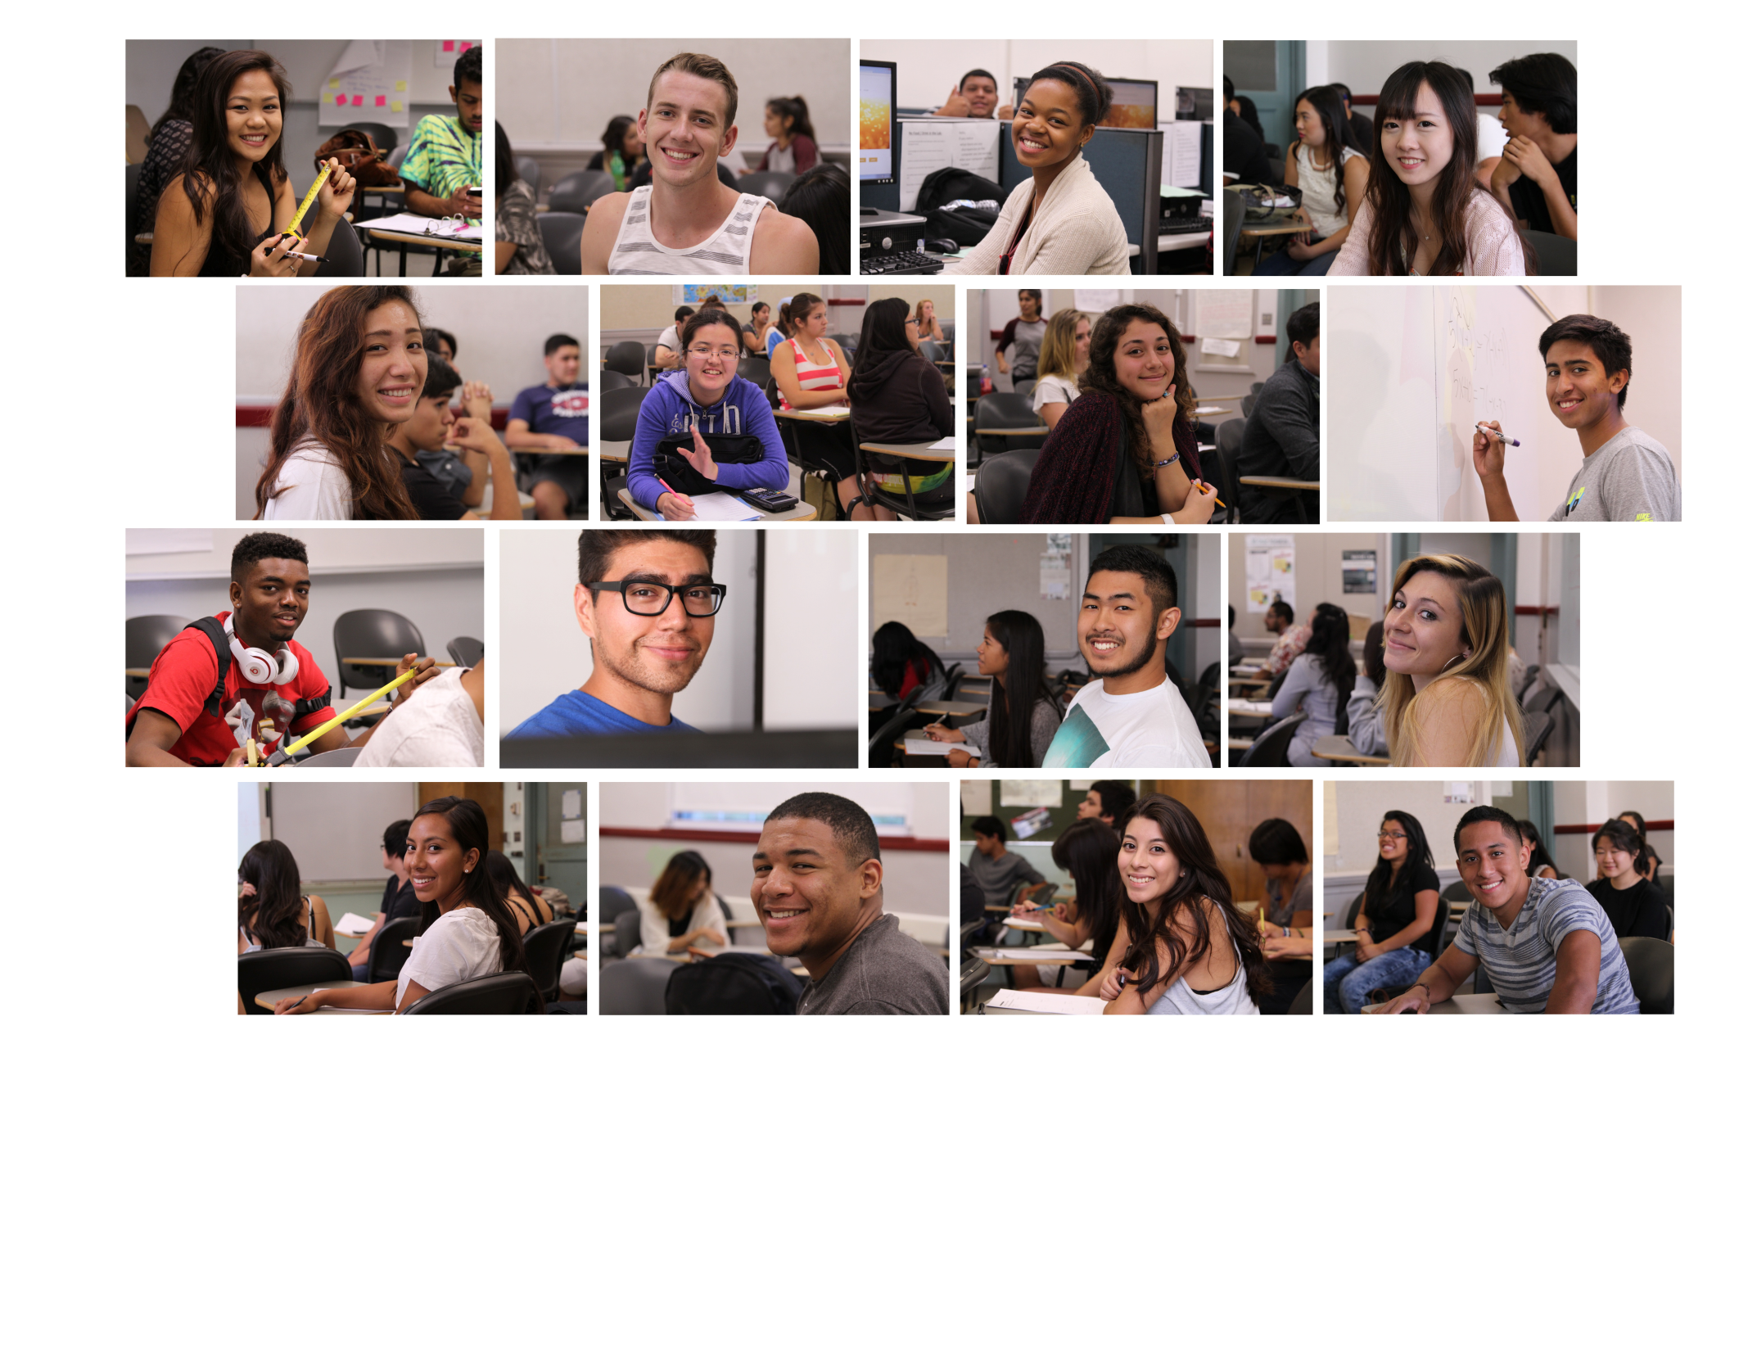
http://pccproject90.org/test-pathway/

