Slide 1

How to Use a Requisition Form for Reimbursement
PCC Office of Student Life

Slide 2
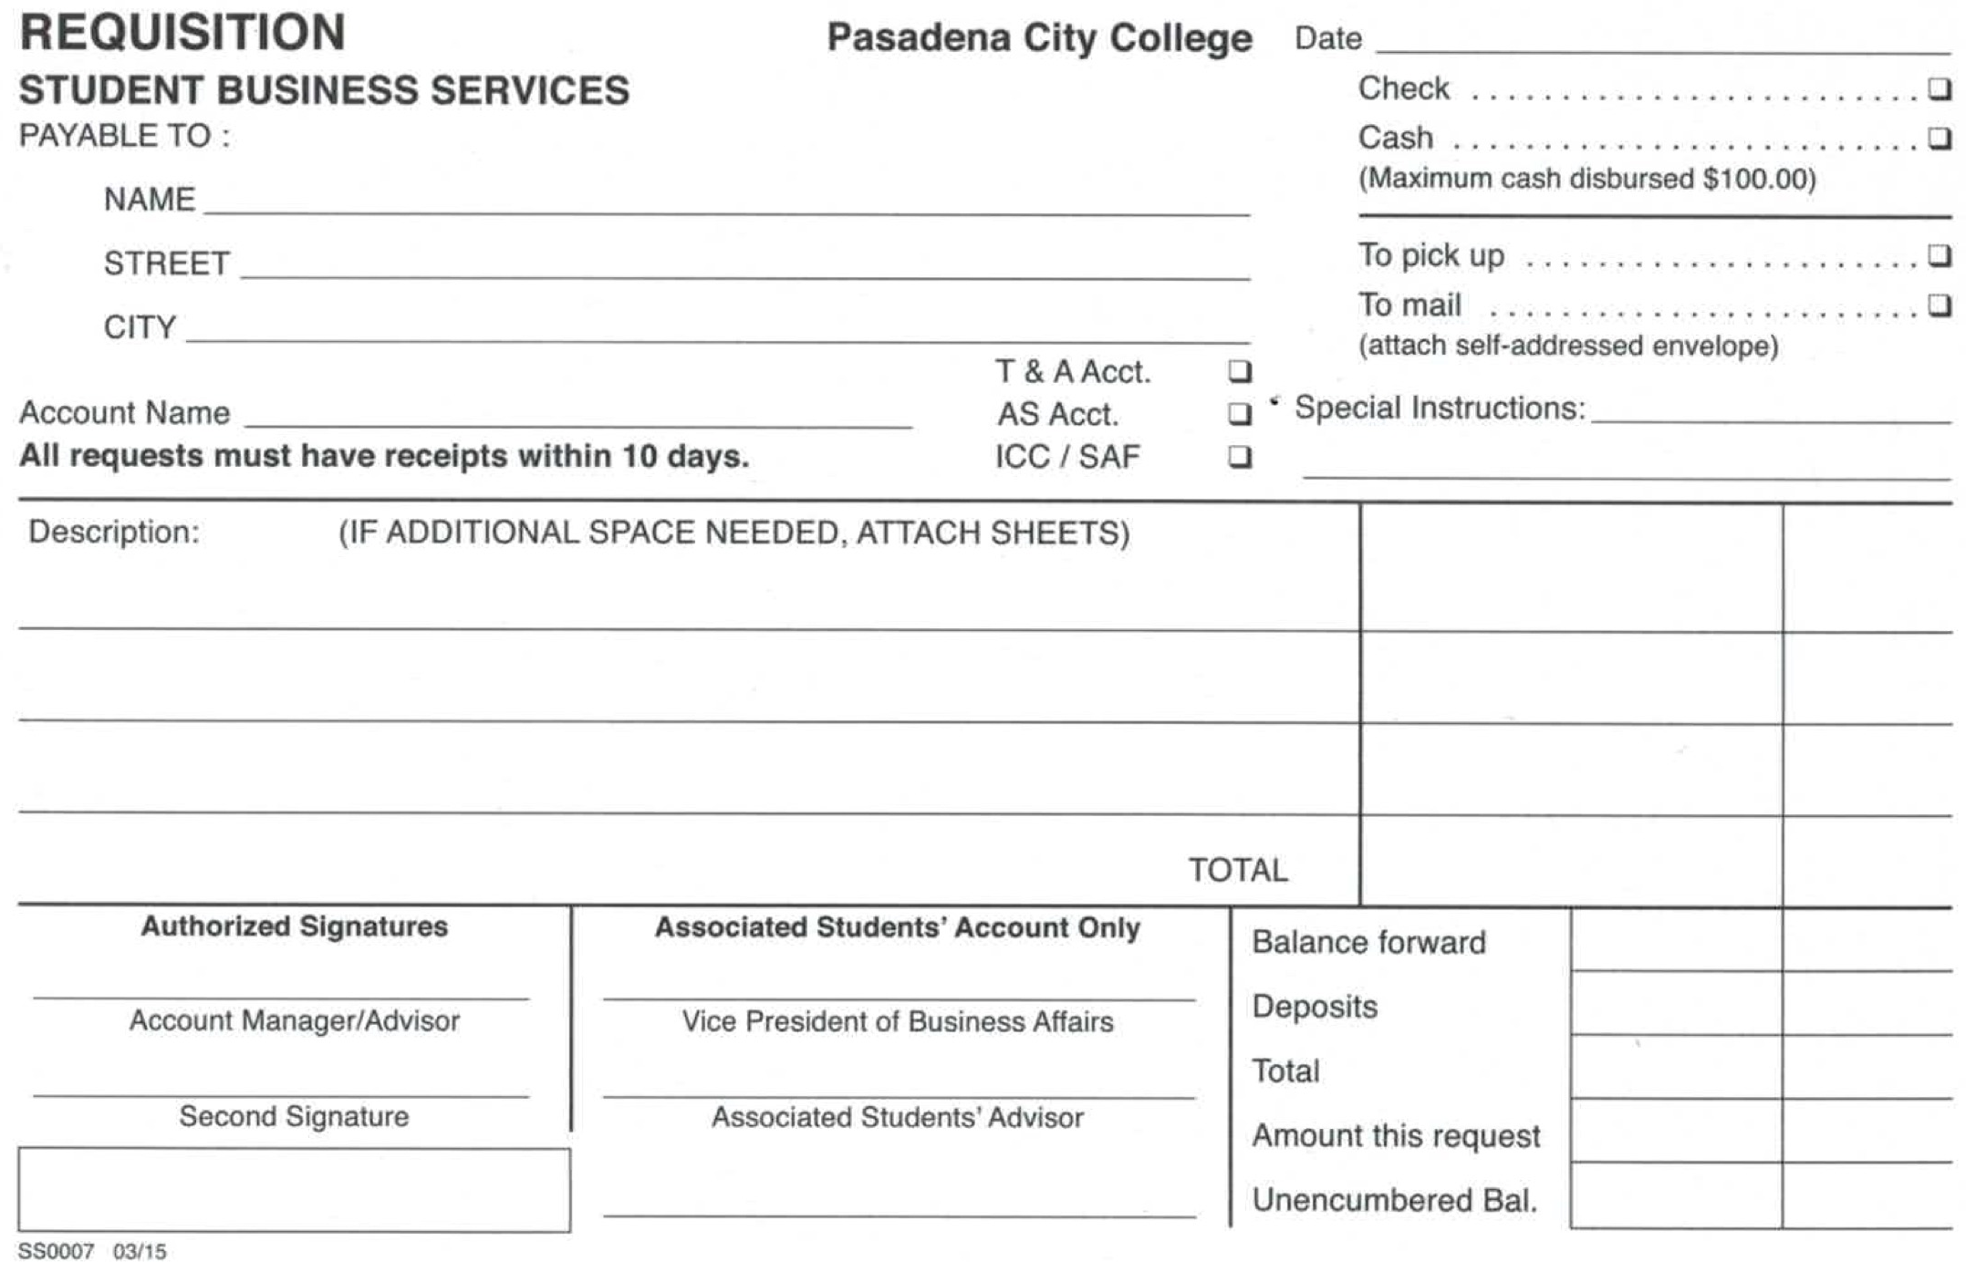
Requisition Form
Notes:
I will be showing you how to use this form to reimburse and pay individuals, companies, services, etc. For example, you may have rented chairs from Dolphins and now it is time to pay them or you purchased supplies for an event with your own money and you need to be reimbursed. This form is going to help you.

Slide 3
NamE & Address
Name - Write or print clearly. This is to whom the check is to be made out to, individual name, company, or account name. Cash can also be disbursed as well (max $100).
Address - Please include complete address (city, state, zip) if check is to be mailed.
Date – Don’t forget to include the date.
Notes:
First things first, at the top you want to write the name, the address and the date. Let’s say you paid for supplies for an event but used your own money, you would put your own name and address. You can receive a check, or cash at a maximum of $100. If you are paying a company, their information would go at the top. Let’s use our previous example of renting chairs from Dolphins. For name, street, city you would put Dolphins information, not your own, because they are the ones being paid. Consider if you want to pay them in cash, as cash has no paper trail if something were to happen. It is recommended to pay with check. You can also decide if the funds will be picked up or mailed, if mailed, make sure you attach an addressed envelope.

Slide 4
Account Name
Account Name – Name, such as business support, campus activities, club name (Be sure to check the AS Acct box or T&A acct if this is a T&A account requisition).
Notes:
Which account is the money coming out from?

Slide 5
Description
Description - Reason for cash or check. A reimbursement of, a purchase of, an advance for something. Be as descriptive as possible. Please do not leave blank. Include day and date of event, location of event, and any other pertinent information.

Slide 6
Total
Total - If there are several items please list, and then total. If there is one total, write it twice as shown.
42. 50
42. 50
Notes:
Total. Here you will list the items, add them together and include the total. If there is one total, write it twice as shown.

Slide 7
Authorized Signers
Each requisition must have two signatures.
Associated Students: Vice President for Business affairs or AS President and Carrie Afuso or Dean Rebecca Cobb
T&A Account: One student officer, one advisor and if it is over $100, Carrie Afuso or Dean Rebecca Cobb
ICC/SAF: One student officer, one advisor and approval by Executive Vice President of Associated Students
Notes:
T&A Account: One student officer, one advisor (does not have to be primary, needs to be whoever signed signature card)

Slide 8
Authorized Signers

Slide 9
Payment for Service
Payment for Service - If an individual or group is being paid for a service (such as a band performance), the complete address, SS#, W9 Form, and a copy of the performer contract must be included, or check will not be released.

Slide 10
Receipts
Receipts - All requisitions require a receipt and they must be within 10 days. This includes cash requisitions. A copy of original receipt is required.

