Slide 1
2018 African American High School Conference
Pasadena City College

Slide 2
LETS PICK A DATE
MARCH 29, 2019
APRIL 5, 2019
APRIL 12, 2019
APRIL 19, 2019

Slide 3
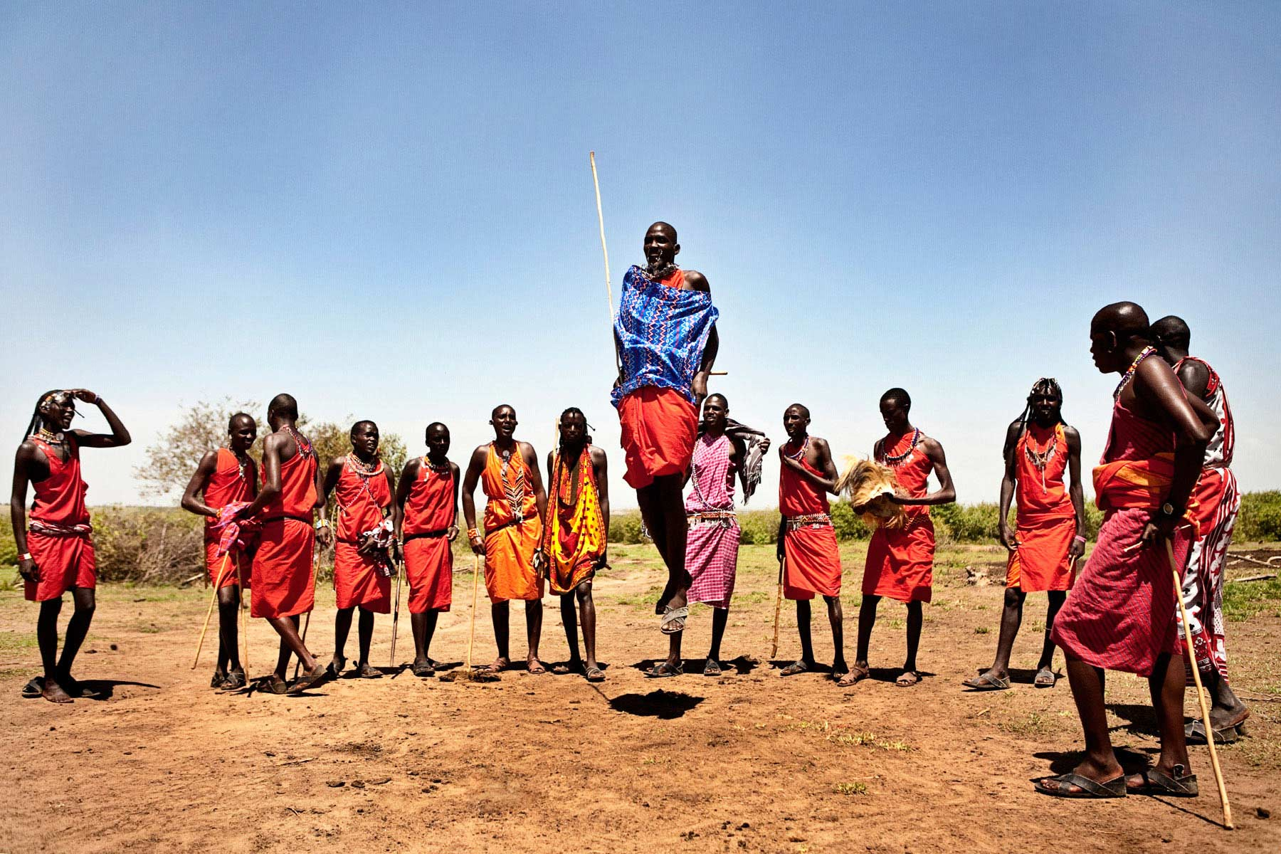
2018 PASADENA CITY COLLEGE AFRICAN AMERICAN HIGH SCHOOL CONFERENCE
Schedule
Open
Keynote
Workshop Presenters
Lunch, Wrap-Up
Sponsors
Iconography/ Signage

Slide 4
SCHEDULE AT A GLANCE
7:30am-8:00am- Bus pick up from school sites and drop off at PCC
8:00am-8:30am- Registration and Continental Breakfast
8:30am-8:45am- Conference Open (Poem) (Drummers??), Lift Every Voice Welcome, Conference Overview
8:45am-9:05am- Intro Keynote, Keynote
9:15am-10:00am- Breakout Session One (Men/Women)
10:10am-11:00am-Concurrent Workshops, Counselor sessions
11:10am-12:00pm-Concurrent Workshops, Counselor sessions
12:00pm-1:30pm- Lunch, Raffle,

Slide 5
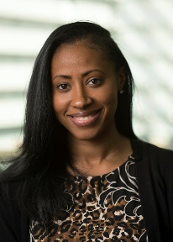
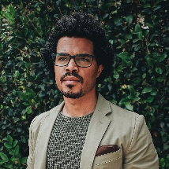
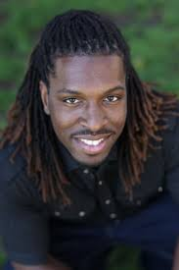
KEYNOTE SPEAKERS
1
Jamira Burley
2
Charles Davis III
3
Mir Harris
4
Charles Dorsey

Slide 6
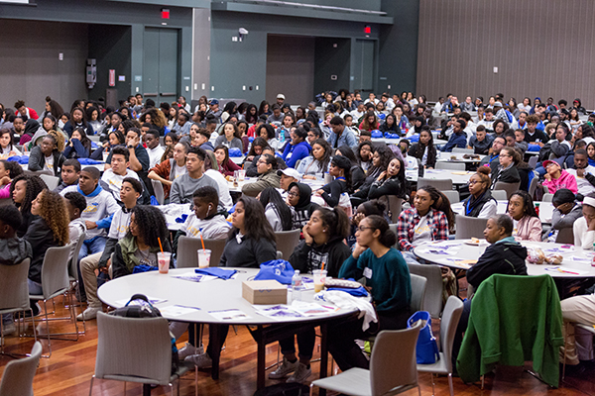
WORKSHOPS
Arts and Entertainment- Panel on Careers, Content Creation, Building your own brand
Trio Programs/ College Going Culture- College planning, Talking through college support programs available at PCC, TRIO
Women and Men sessions- Panel, Speaker, Games???
Know Your Rights- PPD, BLM??, ACLU
Financial Literacy- Financial Literacy , Cashflow
Counselor Workshops-????

Slide 7
Lunch Warp-up
Lunch serving as conference wrap up and evaluation
1
Students must submit evaluation to get lunch
2
Stepshow???, Wyann, DJ, Giveaways
3
Dismissal, Transport, Debrief
Hint: WHAT IS MISSING?

Slide 8
Budget
Keynote- 3000-5000
Workshops 1000-2000
Step Show 1000
DJ 500
T-shirts ?????
Bags ?????
Supplies ????
Food ?????
Advertisement ?????

Slide 9
SPONSORS
Primary funding sources include.
1
Associated Student Funds
2
Internal Partners
3
Outside Partnerships

Slide 10
ICONAGRAPHY
Message
SELECT ME
Pasadena City College welcomes high school students from Pasadena, Monrovia, and Arcadia to campus for the 28th annual African-American High School Conference. The event will take place at the PCC Community Education Center. The academic conference is free to local African-American high school students and will feature workshops about higher education, career exploration, personal development, and cultural enrichment. The conference will also include a number of presentations by PCC faculty, staff, and students, as well as community leaders. The mission of the PCC African-American High School Conference is to promote positive development in African-American youth and to empower high school students to appreciate the value of higher education
LOGO
TSHIRTS
GIVEAWAYS
?????

